Slide 1
A heuristic approach for detecting RNA H-type pseudoknots
Chun-Hsiang Huang, Chin Lung Lu and Hsien-Tai Chiu
Department of Biological Science and Technology, National Chiao Tung University,Hsinchu 300, Taiwan, Republic of China
Date: Nov. 7, 2007
Speaker: Chia-Hung Chang

Slide 2
Abstract
Motivation: RNA H-type pseudoknots are ubiquitous pseudoknots that are found in almost all classes of RNA and thought to play very important roles in a variety of biological processes. Detection of these RNA H-type pseudoknots can improve our understanding of RNA structures and their associated functions. However, the currently existing programs for detecting such RNA H-type pseudoknots are still time consuming and sometimes even ineffective. Therefore, efficient and effective tools for detecting the RNA H-type pseudoknots are needed.

Slide 3
Results: In this paper, we have adopted a heuristic approach to develop a novel tool, called HPknotter, for efficiently and accurately detecting H-type pseudoknots in an RNA sequence. In addition, we have demonstrated the applicability and effectiveness of HPknotter by testing on some sequences with known H-type pseudoknots. Our approach can be easily extended and applied to other classes of more general pseudoknots.

Slide 4
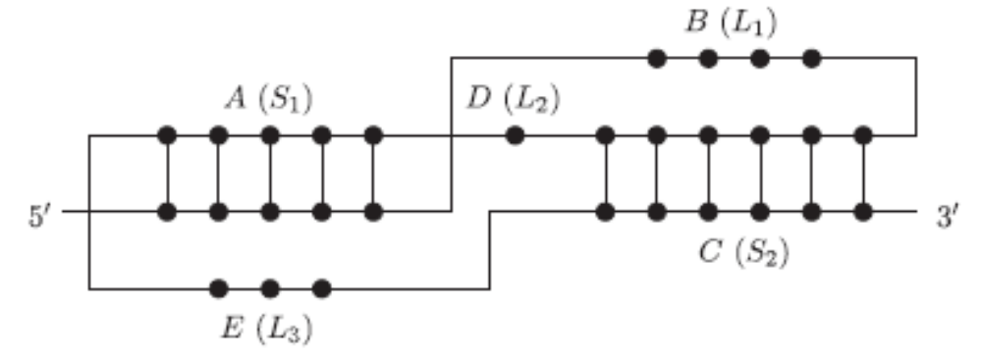
What are pseudoknots?

Slide 5
Input & Output
Input:
  Sequence data in FASTA format
Output:
  Predicted H-pseudoknots

Slide 6
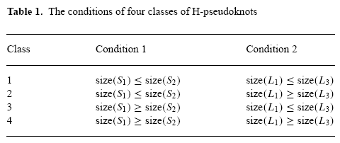
The descriptors

Slide 7
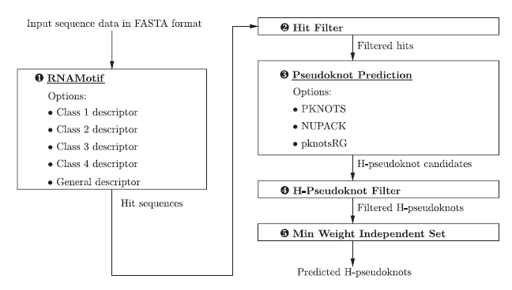
Algorithm
MAX.

Slide 8
Evaluation
S_{bp} = (100 * TP) / (TP + FN) (sensitivity)
P_{bp} = (100 * TP) / (TP + FP) (specificity)
Π = (number of correctly predicted H-pseudoknots) / (number of predicted H-pseudoknots)

Slide 9
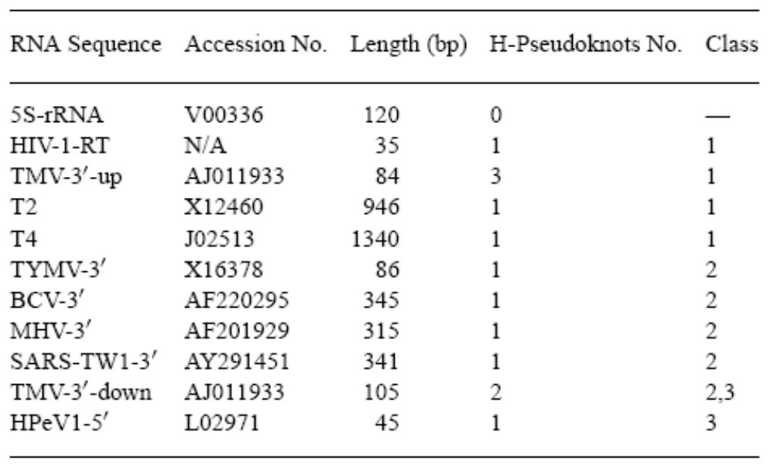
Tested sequences

Slide 10
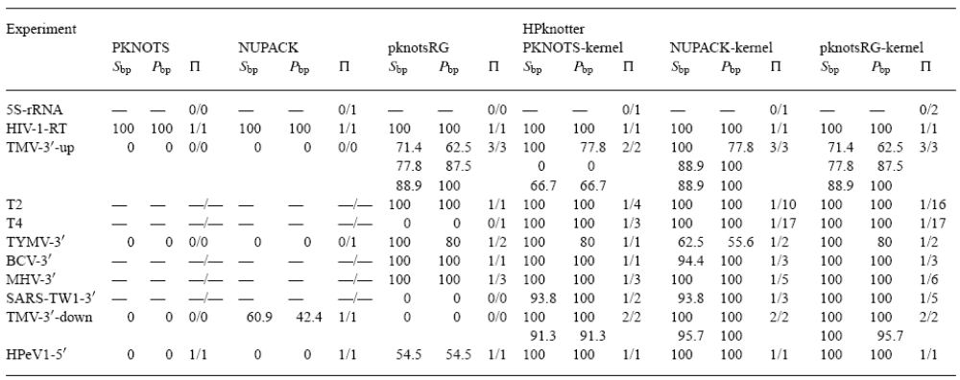
Result

Slide 11
